Slide 1
Análisis de Datos con Valores No Detectados (Censurados)
Dr. Gerardo Gold Bouchot
Gerente del Proyecto
”Proyecto de Implementación del Plan de Acción Estratégica del Gran Ecosistema Marino del Golfo de México”

Slide 2
¿Qué no es esto?
No es un curso de estadística
No es un curso de de estadística de datos censurados
  Se está pensando en la posibilidad de un curso si hay suficiente interés
Se van a cubrir los fundamentos*
*Que no son rudimentos

Slide 3
Detection Limit
There are two types of detection limits:
Instrumental Detection Limit (IDL)
Most analytical instruments produce a signal, even in the absence of a sample (i.e. in a blank). This signal is “noise”, and it is produced by small oscillations in the detector, lamp, injector, temperature, electric power (including electric grounding), etc.
The detection limit (DL) is the concentration of a sample that produces a signal that is significantly different from the noise (3 times highger than the standard deviation of the noise).
Some times the “practical detection limit” is used (lowest point in the calibration curve).

Slide 4
Method Detection Limit (MDL)
Sample preparation (extraction, digestion, combustion, concentration, etc.), and sample matrix (tissue, sediments, sea water) introduce more noise.
It is calculated using blanks taken through the complete analytical procedure.
Thus the detection limit for the method will be higher (worse) than the instrumental detection limit.
The MDL is the value that has to be reported.

Slide 5
Quantification Limit
Quantification Limit (MDL)
Is usually defined as 10 times the standard deviation of the blank, and it is the lowest concentration that can be reported.

Slide 6
Reporting Conventions
Under the detection limit, reported as:
  Not Detected (ND)
Between the detection and quantification limits, reported as:
  Traces
Above the quantification limit, reported as:
  Number
Frequently only the instrumental detection limit is reported.

Slide 7
Quality Control and Assurance (QA/QC)
Determining the detection limit is an impostant part of the QA/QC procedures
QA/QC includes:
Calibration curve
  Seven points
  r² > 0.9999
Blanks
Spiked blanks
Standard Reference Materials (expensive!)
Duplicate samples
Etc.
It usually represents around 25 – 35% of analytical costs

Slide 8
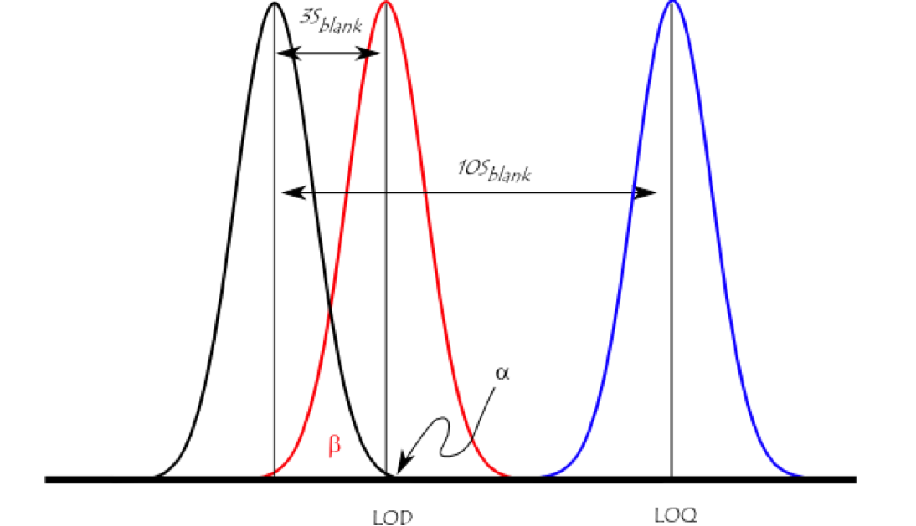
Statistics 101

Slide 9
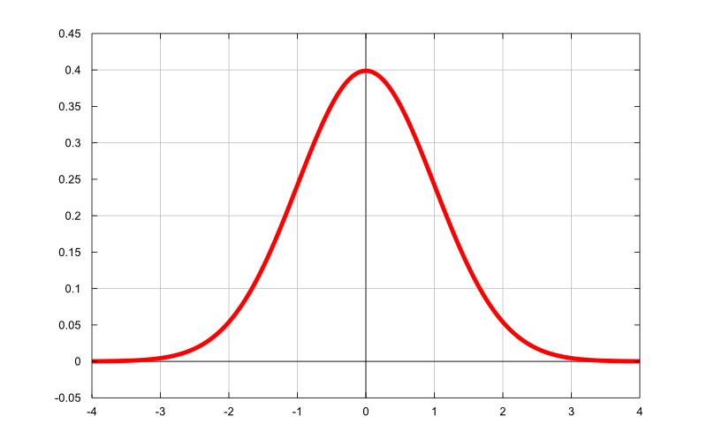

The existence of a detection limit has implications
The shape of the probability distribution can change
Lognormal distributions are often “normalized” by
logtransformation.
LogNormal Distribution
Normal Distribution
Detection Limit

Slide 10
There can be other problems:
Biased means and standard deviations
Biased estimators
Beware of transformation bias!
Report results in the original
scale!
Geometric Mean

Slide 11
What to do with non-detects (NDs, values below the detection limit)?
Many people substitute NDs by 0
  Very bad idea!
  Introduces bias in the results
Substitute by 0.5 DL
  Was suggested by EPA for a long time
  Better than substituting by 0, but not perfect.

Slide 12
What to do with non-detects (NDs, values below the detection limit)?
There are statistical methods designed to deal with NDs
  Many based on survival analysis techniques
  If interested check the book:
  Dennis R. Helsel. 2012. Statistics for Censored Environmental Data Using Minitab and R. Second Edition. Wiley Series in Statistics in practice.
  There is a newer free statistics book, that has some new advise:
  Helsel, D.R., Hirsch, R.M., Ryberg, K.R., Archfield, S.A., and Gilroy, E.J., 2020. Statistical methods in water resources: U.S. Geological Survey Techniques and Methods, book 4, chapter A3, 458 p., https://doi.org/10.3133/tm4a3

Slide 13
What to do with non-detects (NDs, values below the detection limit)? . . .
There is free software available:
NADA and NADA2 packages for R
  NADA is also available for Minitab, but Minitab is not free.
  Download R here: The Comprehensive R Archive Network
  R is a statistical environment, and it has over 6,000 free packages
  There are several free GUIs (JAMOVI, JASP, BlueSky Statistics)
  It is advisible to use it with Rstudio, also free: RStudio Desktop - Posit
ProUCL version 5.2
  Citation: USEPA. ProUCL: Statistical Software for Environmental Applications for Data Sets With and Without Nondetect Observations. Version 5.2. https://www.epa.gov/land-research/proucl-software, 2022.
  The Technical Guide discusses extensively statistical techniques, to use with and without NDs, including techniques not available in NADA2.

Slide 14
Other free software
Visual Sample Plan (Visual Sample Plan | PNNL)
Free software to do sampling designs
  Legally and scientifically defendible designs
It has a statistical module:
  It can handle Nondetects
  Takes into account the sampling design
  i.e. it handles spatial autocorrelation
VSP helps users obtain answers to these questions:
How many samples do I need?
Where should I take samples?
What decisions do my data support?
How confident am I in those decisions?

Slide 15
Outliers
Extremely high or low values
Complicated to deal with statistically
  First check for typos, errors, etc.
  Are they really outliers?
In pollution studies, take a careful look at extremely high values
  They may indicate hotspots!
  Do not delete them automatically!

Slide 16
¿Preguntas?
¿Comentarios?
¿Reclamaciones?
¿Objeciones?
¡Últimas dos enviar al IMTA! :)
¡¡¡Gracias!!!
Correo de trabajo: gerardogb@unops.org

